Slide 1

Cache Coherence
Presented by:
Nikesh Maharjan
Prerit Basnet

Slide 2
Topics
Cache Coherence
Solution to Cache Coherence Problem
Hardware solution
- Directory protocols
- Snoopy protocols
Software solution

Slide 3
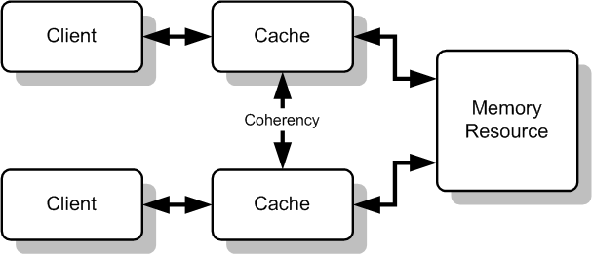
Cache Coherence
In computer architecture, cache coherence is the uniformity of shared resource data that ends up stored in multiple local caches.
Notes:
Multiple copies of the same data can exist in different caches simultaneously, and if process are allowed to update their own copies freely,an inconsistent view of memory can result known as cache
coherence problem

Slide 4
Cache Coherence
Requirements for cache coherence
Write Propagation
Changes to the data in any cache must be propagated to other copies(of that cache line) in the peer caches.
Transaction Serialization
Reads/Writes to a single memory location must be seen by all processors in the same order.

Slide 5
Solution to Cache Coherence Problem
Hardware Solution
It is generally referred to as cache coherence protocols.
can be generally divided into two categories:
Directory Protocols
collects and maintain information about where copies of line reside.
contains the information about content of various local caches.
responsible for keeping information up-to-date.
Drawback: works only for less buses,not suitable for large scale system.

Slide 6
Solution to Cache Coherence Problem
Snoopy protocols
responsible for maintaining cache coherence among all of the cache controller in multiprocessor.
Two basic approaches:
Write invalid protocol
multiple readers but only one writer at a time ,only one cache can write to the line.
Write update protocol
multiple writer as well as multiple readers

Slide 7
Solution to Cache Coherence Problem
Software Solution
software based protocol which rely on the compiler and operating system to deal with the problem.
performs an analysis on the code to determine which data items may become unsafe for caching and mark those time.
prevent any shared data variables from being cached.

Slide 8
Any Questions
?

Slide 9
Thank you!

